Slide 1
HTML
By:- Akshay R Sonavane
Professional photographer, creative animator/game maker, elite programmer, Multi-platform app maker
effective hacker and expert web developer.

Slide 2
What is HTML?
HTML is short for "Hyper Text Markup Language".
It simply means it is a language for describing web-pages using ordinary text.
All HTML documents must start with a type declaration: <!DOCTYPE html>.
The HTML document itself begins with <html> and ends with </html>.
The visible part of the HTML document is between <body> and </body>.

Slide 3
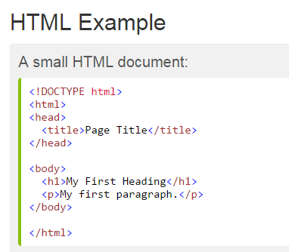
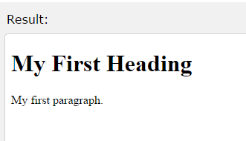
HTML tag

Slide 4
HTML Files
Every web page is actually a HTML file.
Each HTML file is just a plain-text file, but with a .html file extension instead of .txt, and is made up of many HTML tags as well as the content for a web page.
A web site will often contain many html files that link to each other. You can edit HTML files with your favorite editor. Like Adobe Dreamweaver, Microsoft Expression Web, Coffee Cup HTML Editor

Slide 5
HTML Tags
HTML tags are the hidden keywords within a web page that define how the browser must format and display the content.
Most tags must have two parts, an opening and a closing part.
For example, <html> is the opening tag and </html> is the closing tag. Note that the closing tag has the same text as the opening tag, but has an additional forward-slash ( / ) character.
The purpose of a web browser (Chrome, IE, Firefox, Safari) is to read HTML documents and display them.
The browser does not display the HTML tags, but uses them to determine how to display the document:

Slide 6
The DOCTYPE declaration defines the document type to be HTML
The text between <html> and </html> describes an HTML document
The text between <head> and </head> provides information about the document
The text between <title> and </title> provides a title for the document
The text between <body> and </body> describes the visible page content
The text between <h1> and </h1> describes a heading
The text between <p> and </p> describes a paragraph

Slide 7
HTML Elements
An HTML element is defined by a starting tag. If the element contains other content, it ends with a closing tag, where the element name is preceded by a forward slash as shown below with few tags:
Start Tag | Content | End Tag
<p> | This is paragraph content. | </p>
<h1> | This is heading content. | </h1>
<div> | This is division content. | </div>
<br />

Slide 8
Here <p>....</p> is an HTML element, <h1>...</h1> is another HTML element.
There are some HTML elements which don't need to be closed, such as <img.../>, <hr /> and <br /> elements.
These are known as void elements.
HTML documents consist of a tree of these elements and they specify how HTML documents should be built, and what kind of content should be placed in what part of an HTML document.
An HTML element is defined by a starting tag. If the element contains other content, it ends with a closing tag.
For example <p> is starting tag of a paragraph and </p> is closing tag of the same paragraph but <p>This is paragraph</p> is a paragraph element

Slide 9
HTML Attributes
An attribute is used to define the characteristics of an HTML element and is placed inside the element's opening tag. All attributes are made up of two parts: a name and a value.
The name is the property you want to set. For example, the paragraph <p> element in the example carries an attribute whose name is align, which you can use to indicate the alignment of paragraph on the page.
The value is what you want the value of the property to be set and always put within quotations. The below example shows three possible values of align attribute: left, center and right.

Slide 10
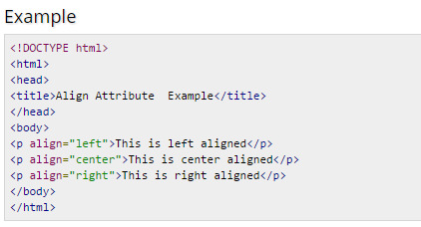

Result

Slide 11
Core Attributes
The four core attributes that can be used on the majority of HTML elements are:
Id
Title
Class
style

Slide 12
The id Attribute
The id attribute of an HTML tag can be used to uniquely identify any element within an HTML page. There are two primary reasons that you might want to use an id attribute on an element:
If an element carries an id attribute as a unique identifier it is possible to identify just that element and its content.
If you have two elements of the same name within a Web page (or style sheet), you can use the id attribute to distinguish between elements that have the same name.
Example:
<p id="html">This para explains what is HTML</p>
<p id="css">This para explains what is Cascading Style Sheet</p>

Slide 13
The title Attribute
The title attribute gives a suggested title for the element. They syntax for the title attribute is similar as explained for id attribute:
Example
<!DOCTYPE html>
<html>
<head>
<title>The title Attribute Example</title>
</head>
<body>
<h3 title="Hello HTML!">Titled Heading Tag Example</h3>
</body>
</html>

Slide 14
The class Attribute
The class attribute is used to associate an element with a style sheet, and specifies the class of element.
Example:
class="className1 className2 className3"

Slide 15
The style Attribute
The style attribute allows you to specify Casecading Style Sheet (CSS) rules within the element.
Example:
<!DOCTYPE html>
<html>
<head>
<title>The style Attribute</title>
</head>
<body>
<p style="font-family:arial; color:#FF0000;">Some text...</p>
</body>
</html>

Slide 16
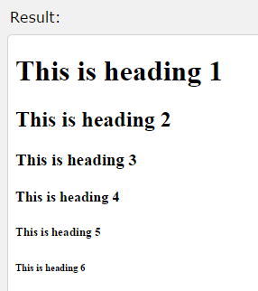
HTML Headings
Headings are defined with the <h1> to <h6> tags.
<h1> defines the most important heading. <h6> defines the least important heading.
Example:
<!DOCTYPE html>
<html>
<body>
<h1>This is heading 1</h1>
<h2>This is heading 2</h2>
<h3>This is heading 3</h3>
<h4>This is heading 4</h4>
<h5>This is heading 5</h5>
<h6>This is heading 6</h6>
</body>
</html>

Slide 17
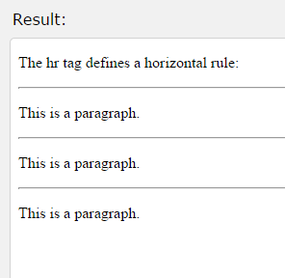
<hr> tag
The <hr> tag creates a horizontal line in an HTML page.
The hr element can be used to separate content:
Example:
<!DOCTYPE html>
<html>
<body>
<p>The hr tag defines a horizontal rule:</p>
<hr>
<p>This is a paragraph.</p>
<hr>
<p>This is a paragraph.</p>
<hr>
<p>This is a paragraph.</p>
</body>
</html>

Slide 18
HTML Paragraphs
<p> </p> element
The HTML <p> element defines a paragraph.
In HTML You cannot be sure how HTML will be displayed.
Large or small screens, and resized windows will create different results.
With HTML, you cannot change the output by adding extra spaces or extra lines in your HTML code.
The browser will remove extra spaces and extra lines when the page is displayed.
Any number of spaces, and any number of new lines, count as only one space.

Slide 19
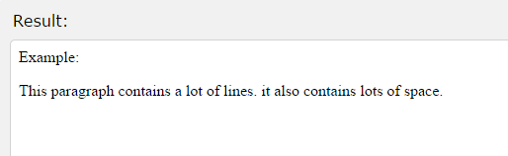
Example:
<!DOCTYPE html>
<html>
<body>
<p>
This paragraph
contains a lot
of lines.
it also contains lots
of space.
</p>
</body>
</html>

Slide 20
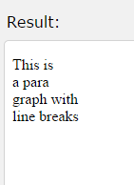
<br> element
The HTML <br> element defines a line break.
Use <br> if you want a line break (a new line) without starting a new paragraph
The <br> element is an empty HTML element. It has no end tag.
Example :
<!DOCTYPE html>
<html>
<body>
<p>This is<br>a para<br>graph with<br> line breaks</p>
</body>
</html>

Slide 21
<pre> element
The HTML <pre> element defines preformatted text.
The text inside a <pre> element is displayed in a fixed-width font.
It is used for poem writing.
Example:
<!DOCTYPE html>
<html>
<body>
<p>The pre tag preserves both spaces and line breaks:</p>
<pre>
My Bonnie lies over the ocean.
My Bonnie lies over the sea.
My Bonnie lies over the ocean.
Oh, bring back my Bonnie to me.
</pre>
</body>
</html>

Slide 22
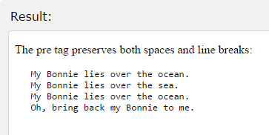

Slide 23
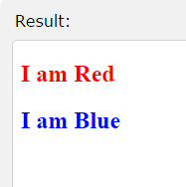
HTML Styles
Every HTML element has a default style (background color is white and text color is black).
Changing the default style of an HTML element, can be done with the style attribute.
The HTML style attribute has the following syntax:
style="property:value“
Example:
<!DOCTYPE html>
<html><body>
<h2 style="color:red">I am Red</h2>
<h2 style="color:blue">I am Blue</h2>
</body> </html>

Slide 24
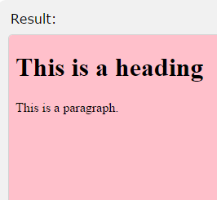
Change Background color:
Example:
<!DOCTYPE html>
<html>
<body style="background-color:pink">
<h1>This is a heading</h1>
<p>This is a paragraph.</p>
</body>
</html>

Slide 25
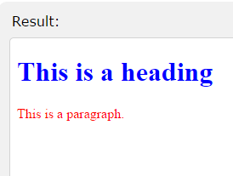
Change Text Color
Example :
<!DOCTYPE html>
<html>
<body>
<h1 style="color:blue">This is a heading</h1>
<p style="color:red">This is a paragraph.</p>
</body>
</html>

Slide 26
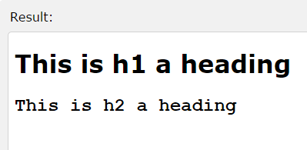
Change font-family
Example:
<!DOCTYPE html>
<html>
<body>
<h1 style="font-family:verdana">
This is h1 a heading</h1>
<h2 style="font-family:courier">
This is h2 a heading</h2>
</body>
</html>

Slide 27
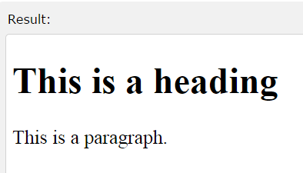
Change Text Size
Example:
<!DOCTYPE html>
<html>
<body>
<h1 style="font-size:300%">
This is a heading
</h1>
<p style="font-size:160%">
This is a paragraph
.</p>
</body>
</html>

Slide 28
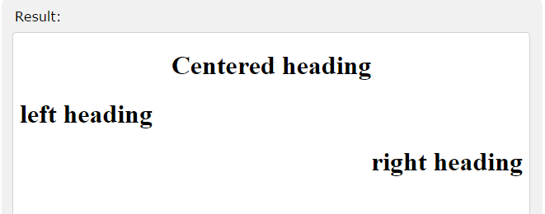
Change Text Alignment
Example:
<!DOCTYPE html>
<html>
<body>
<h1 style="text-align:center"> Centered heading </h1>
<h1 style="text-align:left"> left heading </h1>
<h1 style="text-align:right"> right heading </h1>
</body> </html>

Slide 29
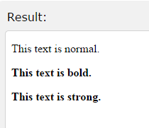
HTML Text Formatting Elements
<b> element or <strong>
The HTML <b> and <strong> element defines bold text, without any extra importance.
Example
<!DOCTYPE html>
<html>
<body>
<p>This text is normal.</p>
<p><b>This text is bold.</b></p>
<p><strong>This text is strong.</strong></p>
</body> </html>

Slide 30
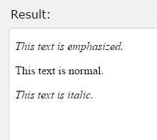
<i> or <em> element
Both defines italic text, without any extra importance.
Example
<!DOCTYPE html>
<html>
<body>
<p><em>This text is emphasized.</em></p>
<p>This text is normal.</p>
<p><i>This text is italic.</i></p>
</body>
</html>

Slide 31
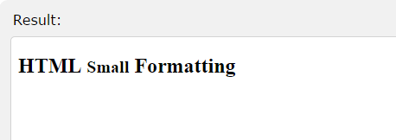
<small> element
The HTML <small> element defines small text:
Example:
<!DOCTYPE html>
<html>
<body>
<h2>HTML <small>Small</small> Formatting</h2>
</body>
</html>

Slide 32
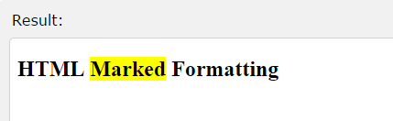
<mark> element
The HTML <mark> element defines marked or highlighted text:
Example
<!DOCTYPE html>
<html>
<body>
<h2>HTML <mark>Marked</mark> Formatting</h2>
</body>
</html>

Slide 33
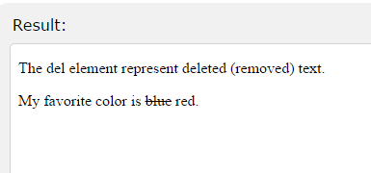
<del> element
The HTML <del> element defines deleted (removed) of text.
Example :
<!DOCTYPE html>
<html>
<body>
<p>The del element represent deleted (removed) text.</p>
<p>My favorite color is <del>blue</del> red.</p>
</body>
</html>

Slide 34
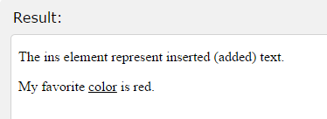
<ins> element
The HTML <ins> element defines inserted (added) text.
Example:
<!DOCTYPE html>
<html>
<body>
<p>The ins element represent inserted (added) text.</p>
<p>My favorite <ins>color</ins> is red.</p>
</body>
</html>

Slide 35
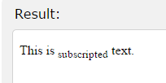
<sub> element
The HTML <sub> element defines subscripted text.
Example:
<!DOCTYPE html>
<html>
<body>
<p>This is <sub>subscripted</sub> text.</p>
</body>
</html>

Slide 36
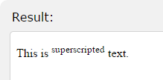
<sup> element
The HTML <sup> element defines superscripted text.
Example:
<!DOCTYPE html>
<html>
<body>
<p>This is <sup>superscripted</sup> text.</p>
</body>
</html>

Slide 37
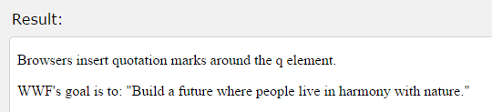
HTML Quotation and Citation Elements
<q> element
The HTML <q> element defines a short quotation.
Example:
<!DOCTYPE html>
<html>
<body>
<p>Browsers insert quotation marks around the q element.</p>
<p>WWF's goal is to: <q>Build a future where people live in harmony with nature.</q></p>
</body> </html>

Slide 38
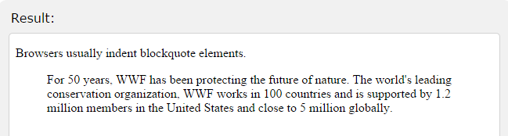
<blockquote> element
The HTML <blockquote> element defines a quoted section.
Example:
<!DOCTYPE html>
<html> <body>
<p>Browsers usually indent blockquote elements.</p>
<blockquote>
For 50 years, WWF has been protecting the future of nature.
The world's leading conservation organization,
WWF works in 100 countries and is supported by
1.2 million members in the United States and
close to 5 million globally.
</blockquote>
</body> </html>

Slide 39
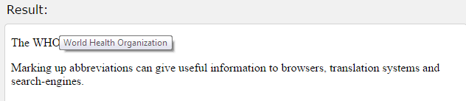
<abbr> element
The HTML <abbr> element defines an abbreviation or an acronym.
Example
<!DOCTYPE html>
<html>
<body>
<p>The <abbr title="World Health Organization">WHO</abbr> was founded in 1948.</p>
<p>Marking up abbreviations can give useful information to browsers, translation systems and search-engines.</p>
</body>
</html>
When we put cursor on abbreviation its full form appear

Slide 40
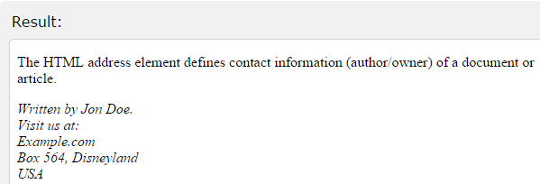
<address> element
The HTML <address> element defines contact information (author/owner) of a document or article.
Example
<!DOCTYPE html>
<html>
<body>
<p>The HTML address
element defines
contact information
(author/owner)
of a document or
article.</p>
<address>
Written by Jon Doe.<br>
Visit us at:<br>
Example.com<br>
Box 564, Disneyland<br>
USA
</address>
</body>
</html>

Slide 41
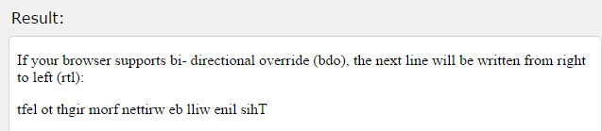
<bdo> element
The HTML <bdo> element defines bi-directional override.
If your browser supports bdo, this text will be written from right to left:
Example
<!DOCTYPE html>
<html>
<body>
<p>If your browser supports bi-directional override (bdo), the next line will be written from right to left (rtl):</p>
<bdo dir="rtl">This line will be written from right to left</bdo>
</body>
</html>

Slide 42
HTML Styles - CSS
CSS stands for Cascading Style Sheets
Styling can be added to HTML elements in 3 ways:
Inline - using a style attribute in HTML elements
Internal - using a <style> element in the HTML <head> section
External - using one or more external CSS files
The most common way to add styling, is to keep the styles in separate CSS files.
SS styling has the following syntax:
element { property:value; property:value }
The element is an HTML element name. The property is a CSS property. The value is a CSS value.

Slide 43
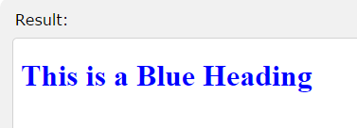
Inline Styling (Inline CSS)
Inline styling is useful for applying a unique style to a single HTML element
Inline styling uses the style attribute.
Example
<!DOCTYPE html>
<html>
<body>
<h1 style="color:blue">
This is a Blue Heading
</h1>
</body>
</html>

Slide 44
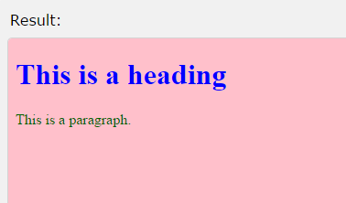
Internal Styling (Internal CSS)
An internal style sheet can be used to define a common style for all HTML elements on a page.
Internal styling is defined in the <head> section of an HTML page, using a <style> element
Example:
<!DOCTYPE html>
<html>
<head>
<style>
body {background-color:pink}
h1 {color:blue}
p {color:darkgreen}
</style>
</head>
<body>
<h1>This is a heading</h1>
<p>This is a paragraph.</p>
</body> </html>

Slide 45
External Styling (External CSS)
External style sheet are ideal when the style is applied to many pages.
With external style sheets, you can change the look of an entire web site by changing one file.
External styles are defined in an external CSS file, and then linked to in the <head> section of an HTML page
Example
<!DOCTYPE html>
<html>
<head>
<link rel="stylesheet" href="styles.css">
</head>
<body>
<h1>This is a heading</h1>
<p>This is a paragraph.</p>
</body>
</html>

Slide 46
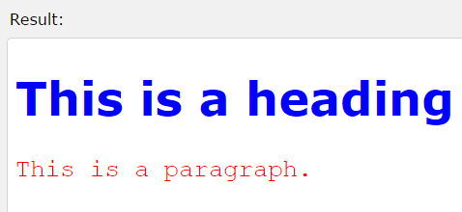
CSS Fonts
The CSS color property defines the text color to be used for the HTML element.
The CSS font-family property defines the font to be used for the HTML element.
The CSS font-size property defines the text size to be used for the HTML element.
Example:
<!DOCTYPE html>
<html>
<head> <style> h1 {color:blue; font-family:verdana; font-size:300%;}
p {color:red; font-family:courier; font-size:160%;} </style>
</head>
<body> <h1>This is a heading</h1> <p>This is a paragraph.</p>
</body> </html>

Slide 47
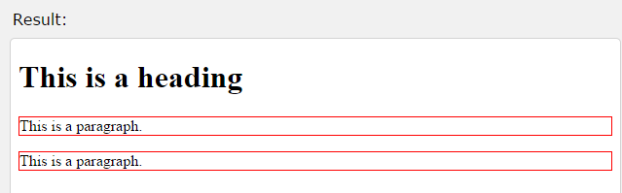
The CSS Box Model
1. Border:
Every HTML element has a box around it, even if you cannot see it.
The CSS border property defines a visible border around an HTML element:
Example
<!DOCTYPE html>
<html>
<head> <style> p {border:1px solid red;} </style> </head>
<body>
<h1>This is a heading</h1> <p>This is a paragraph.</p>
<p>This is a paragraph.</p>
</body>
</html>

Slide 48
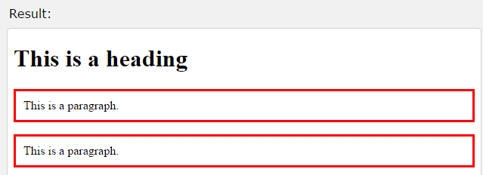
2. Padding
The CSS padding property defines a padding (space) inside the border.
Example
<!DOCTYPE html>
<html>
<head>
<style> p {border:3px solid red;padding:10px;} </style>
</head>
<body>
<h1>This is a heading</h1>
<p>This is a paragraph.</p>
<p>This is a paragraph.</p>
</body>
</html>

Slide 49
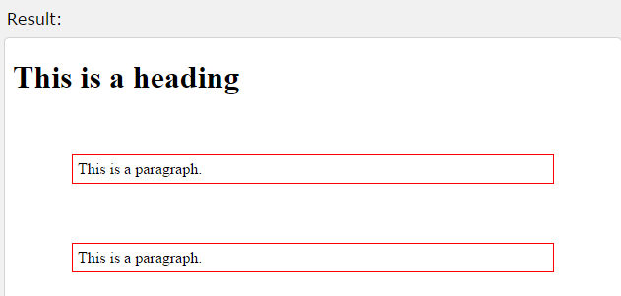
3. Margin
The CSS margin property defines a margin (space) outside the border:
Example
<!DOCTYPE html>
<html><head>
<style>p { border:1px solid red; padding:5px;margin:60px;}
</style></head>
<body>
<h1>This is a heading</h1><p>This is a paragraph.</p>
<p>This is a paragraph.</p>
</body></html>

Slide 50
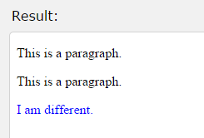
4. The id Attribute
All the examples above use CSS to style HTML elements in a general way.
To define a special style for one special element, first add an id attribute to the element
Example
<!DOCTYPE html>
<html>
<head>
<style>
p#p01 {color: blue;}
</style>
</head>
<body>
<p>This is a paragraph.</p>
<p>This is a paragraph.</p>
<p id="p01">I am different.</p>
</body>
</html>

Slide 51
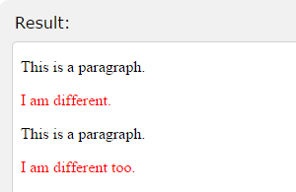
5. The class Attribute
To define a style for a special type (class) of elements, add a class attribute to the element
Example
<!DOCTYPE html>
<html>
<head>
<style>
p.error {color:red;}
</style>
</head>
<body>
<p>This is a paragraph.</p>
<p class="error">I am different.</p>
<p>This is a paragraph.</p>
<p class="error">I am different too.</p>
</body>
</html>

Slide 52
HTML Links
HTML links are hyperlinks.
A hyperlink is a text or an image you can click on, and jump to another document.
In HTML, links are defined with the <a> tag
HTML link syntax is <a href="url"> link text </a>
The href attribute specifies the destination address (http://www.vethics.com)
The link text is the visible part (Visit our HTML tutorial).
Clicking on the link text, will send you to the specified address.

Slide 53
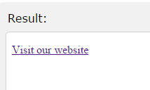

Example :
<!DOCTYPE html>
<html>
<body>
<p>
<a href="http://www.vethics.com">
Visit our website
</a>
</p>
</body>
</html>
By clicking on link the site will open

Slide 54
HTML Images
In HTML, images are defined with the <img> tag.
The <img> tag is empty, it contains attributes only, and does not have a closing tag.
The src attribute defines the url (web address) of the image
The alt attribute specifies an alternate text for the image, if it cannot be displayed.
Its syntax is <img src="url" alt="some_text">
You can use the style attribute to specify the width and height of an image.

Slide 55
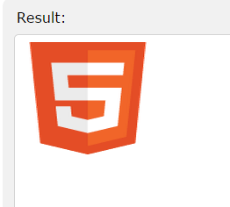
Example
<!DOCTYPE html>
<html>
<body>
<img src="html5.gif" alt="HTML5 Icon" style="width:150px;height:128px">
</body>
</html>

Slide 56
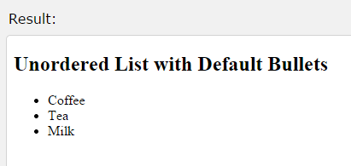
HTML Lists
Unordered HTML Lists
An unordered list starts with the <ul> tag.
Each list item starts with the <li> tag.
The list items will be marked with bullets (small black circles).
Examples
<!DOCTYPE html>
<html>
<body>
<h2>
Unordered List with Default Bullets
</h2>
<ul>
<li>Coffee</li>
<li>Tea</li>
<li>Milk</li>
</ul>
</body>
</html>

Slide 57
Style | Description
list-style-type:disc | The list items will be marked with bullets (default)
list-style-type:circle | The list items will be marked with circles
list-style-type:square | The list items will be marked with squares
list-style-type:none | The list items will not be marked

Slide 58
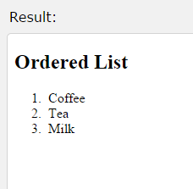
Ordered HTML Lists
An ordered list starts with the <ol> tag.
Each list item starts with the <li> tag.
The list items will be marked with numbers.
Example
<!DOCTYPE html>
<html>
<body>
<h2>Ordered List</h2>
<ol>
<li>Coffee</li>
<li>Tea</li>
<li>Milk</li>
</ol>
</body>
</html>

Slide 59
Type | Description
type="1" | The list items will be numbered with numbers (default)
type="A" | The list items will be numbered with uppercase letters
type="a" | The list items will be numbered with lowercase letters
type="I" | The list items will be numbered with uppercase roman numbers
type="i" | The list items will be numbered with lowercase roman numbers

Slide 60
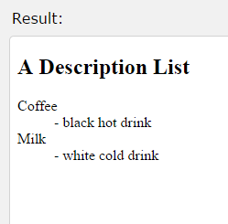
HTML Description Lists
A description list, is a list of terms, with a description of each term.
The <dl> tag defines a description list.
The <dt> tag defines the term (name), and the <dd> tag defines the data (description).
Example
<!DOCTYPE html>
<html>
<body>
<h2>A Description List</h2>
<dl>
<dt>Coffee</dt>
<dd>- black hot drink</dd>
<dt>Milk</dt>
<dd>- white cold drink</dd>
</dl>
</body>
</html>

Slide 61
HTML Tables
Tables are defined with the <table> tag.
Tables are divided into table rows with the <tr> tag.
Table rows are divided into table data with the <td> tag.
A table row can also be divided into table headings with the <th> tag.
If you do not specify a border for the table, it will be displayed without borders.
A border can be added using the border attribute

Slide 62
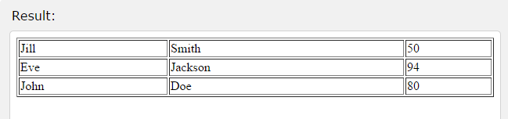
Example
<!DOCTYPE html>
<html>
<body> <table border="1" style="width:100%">
<tr> <td>Jill</td> <td>Smith</td> <td>50</td> </tr>
<tr> <td>Eve</td> <td>Jackson</td> <td>94</td> </tr>
<tr> <td>John</td> <td>Doe</td> <td>80</td> </tr>
</table>
</body>
</html>

